Slide 1
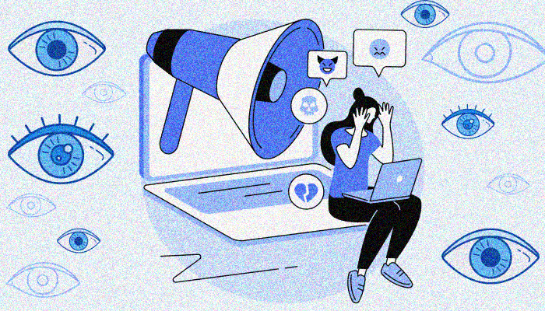
CIPV - Cyber Intimate Partner Violence
CIPV - Cyber Intimate Partner Violence
Di gravina filippo
Di gravina filippo

Slide 2
Introduction and Motivations
Cyber Intimate Partner Violence (C-IPV) is a form of abuse directed towards one’s partner via social media and digital platforms.
C-IPV can come in various forms:
Emotional abuse
Verbal abuse
Physical abuse
The main task is to identify the type of toxicity in a toxic conversation
given a dataset comprised of conversations between a perpetrator and a victim

Slide 3
Related Work
Classification of Cyber Intimate Partner Violence has recently been studied by the paper “LLaMAntino against Cyber Intimate Partner Violence”
The authors answered the two research questions:
RQ1: is the model able to recognize toxic sentences?
RQ2: are the explanations provided with 2-shot prompting similar to the “gold standard” provided by experts?
They got the following results:
few-shot prompting always outperforms zero-shot prompting
even with few-shot prompting, the LLM learns to provide good explanations and learns to detect the presence or the absence of the toxicity

Slide 4

DATASET

Slide 5
dataset
The dataset used in the task is provided by the study by Vito Nicola Losavio called “IDaToC: An Italian Dataset of Toxic Conversation”
This dataset provides:
a thousand of examples of synthetic conversations generated by large language models
the explanation of the toxicity
a binary feature representing if the conversation is toxic or not
a column representing the roles of the two people involved in the conversation

Slide 6
Target variable
This column contains 10 different values:
Controllore e Isolata
Dominante e Schiavo emotivo
Geloso-Ossessivo e Sottomessa
Manipolatore e Dipendente emotiva
Narcisista e Succube
Perfezionista Critico e Insicura Cronica
Persona violenta e Succube
Psicopatico e Adulatrice
Sadico-Crudele e Masochista
Vittimista e Crocerossina

Slide 7

FIRST APPROACHES

Slide 8
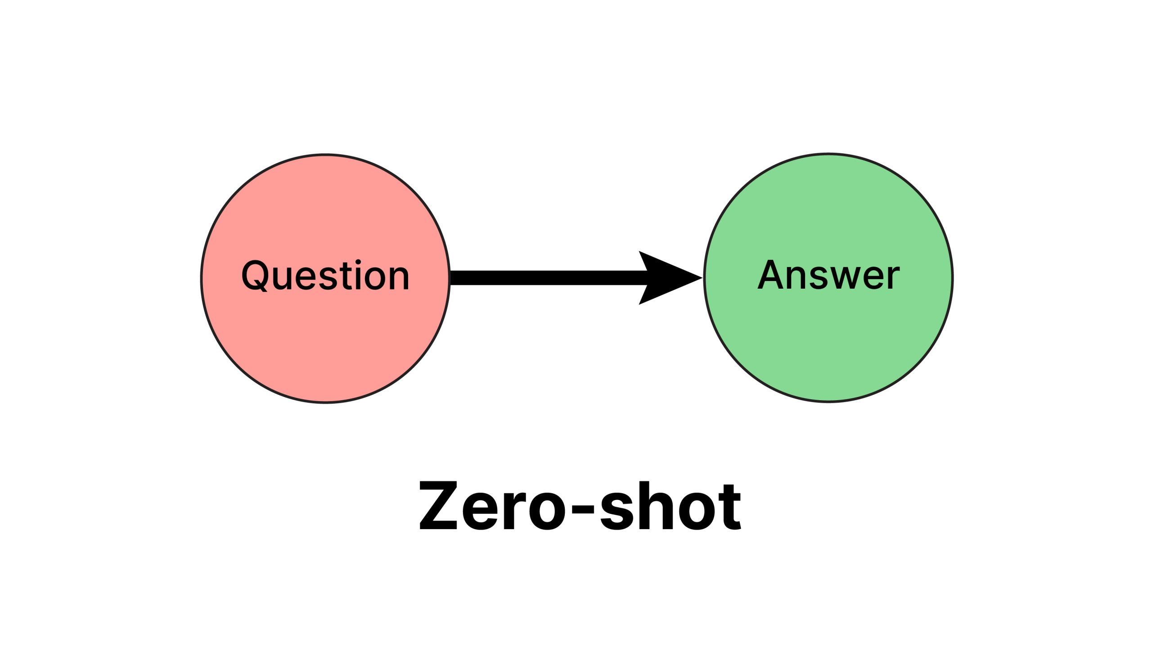
ZERO-SHOT PROMPTING
The zero-shot prompting classification led to very poor results, giving an accuracy score slightly higher than a random guess. Various LLMs have been tested, with the best result in this phase equal to a poor 14% of accuracy. The LLM that gave the best result was meta-llama/llama-4-scout-17b-16e-instruct.

Slide 9
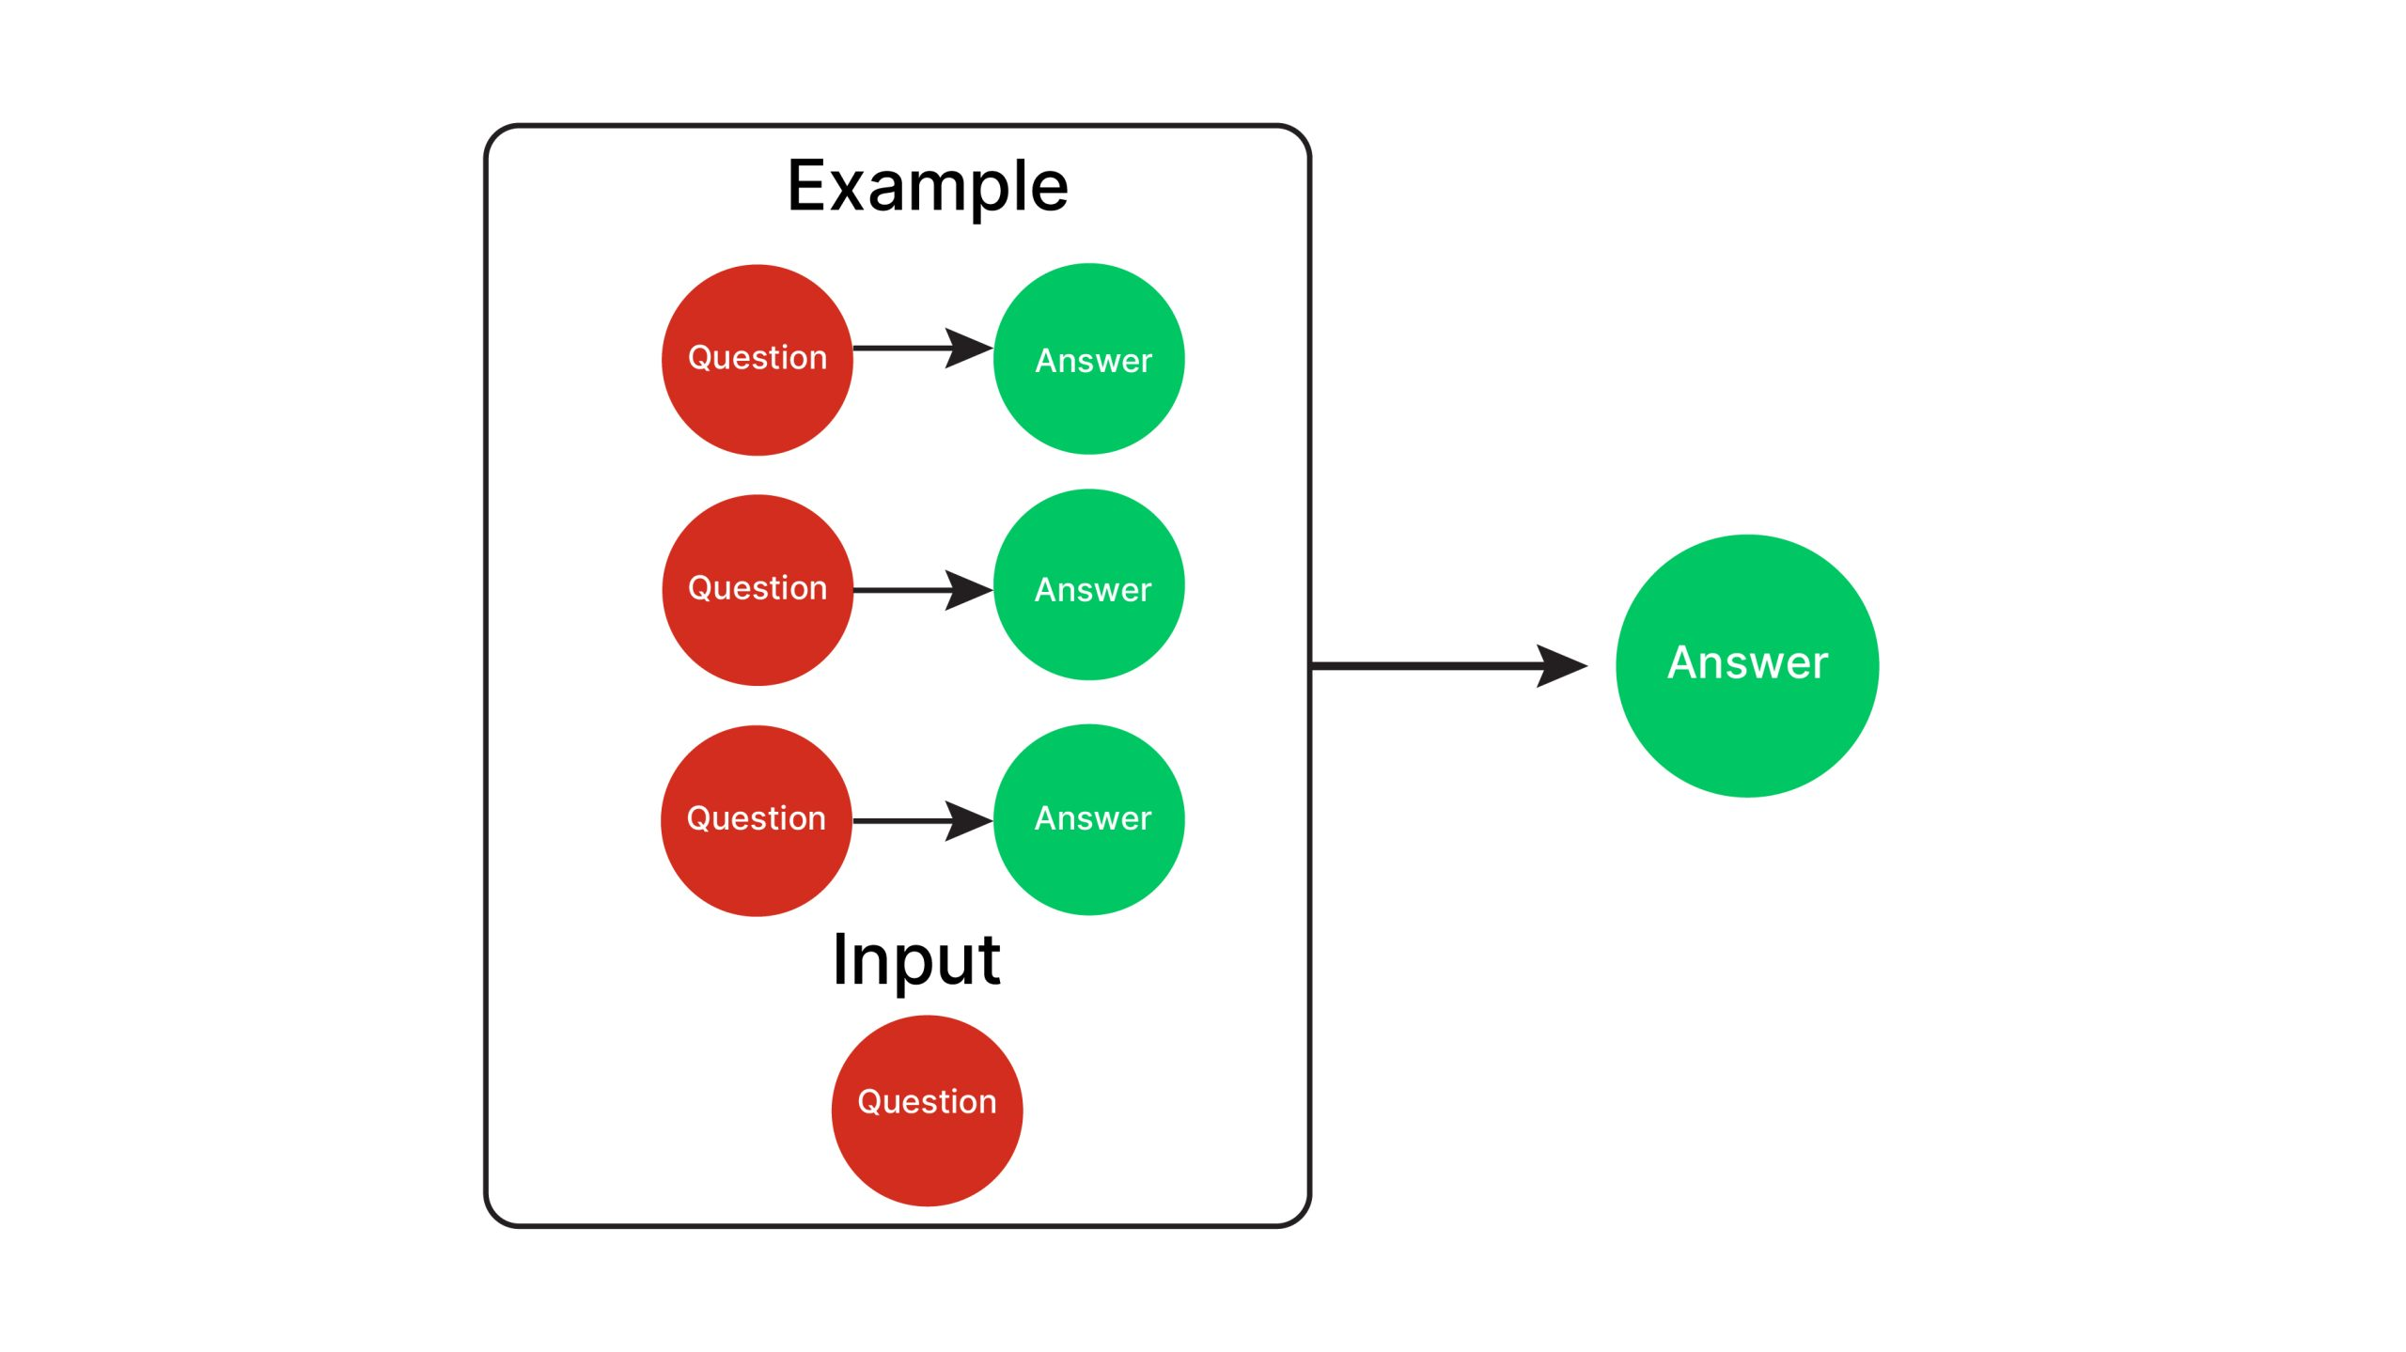
few-SHOT PROMPTING
Few-shot prompting classification gave slightly better results, leading to a 30% accuracy in the best case. These results have been improved by adding some additional information, such as the result of the keyword extraction algorithm, the topic labeling output and giving in input the explanation of the violence available in the dataset.

Slide 10
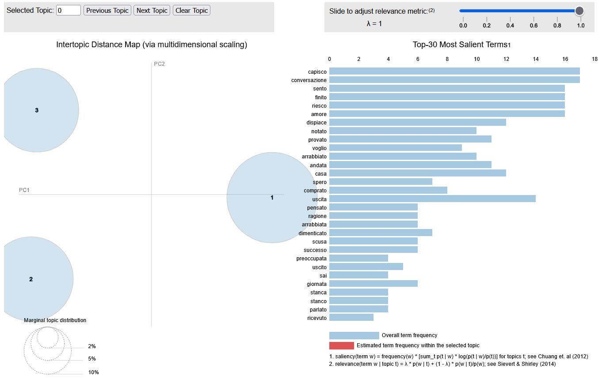
Keyword extraction and topic labeling
Process
LDA interactive web page
The keyword extraction algorithm is used to find the most relevant words in the conversation, in order to focus more attention on the relevant parts of the sentences.
For the same reason, topic labeling has been implemented. The tested approaches are the LSA and the LDA method. The LDA method gave the best results.
The results of the LDA are printed on interactive web pages for improving the readability of the output.

Slide 11
Prompting results
Even with few-shot prompting and additional information, such as:
Keyword extraction
Topic labelling
Explanation
The best result only achieved 45% of accuracy. Even in this case, the LLM that gave the best result was meta-llama/llama-4-scout-17b-16e-instruct.

Slide 12

Proposed Approach
Sentence transformers

Slide 13
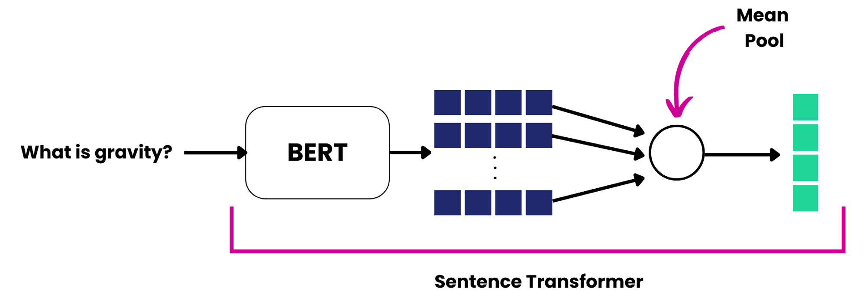
SENTENCE TRANSFORMERS
Sequence transformers are used to encode the input sentences and give these encodings in input to machine learning models that classify these new instances. About ten sequence transformers were tested, and the best sequence transformer turned out to be the model intfloat/multilingual-e5-large.

Slide 14
Tested machine learning models
KNN
Random forest
K-nearest neighbours is a non-parametric, supervised learning classifier. It is a fast algorithm, but in this case it performs the worst in terms of accuracy.
Best result: 53% accuracy.
A random forest is a machine learning algorithm that uses an ensemble of decision trees to make predictions.
Best result: 58% accuracy

Slide 15
Tested machine learning models
Multi-layer perceptron
Multinomial logistic regression
MLP is a feed-forward neural network consisting of fully connected neurons with nonlinear activation functions.
Best result: 60% accuracy
It is a model that is used to predict the probabilities of the different possible outcomes of a categorically distributed dependent variable.
Best result: 62% accuracy

Slide 16
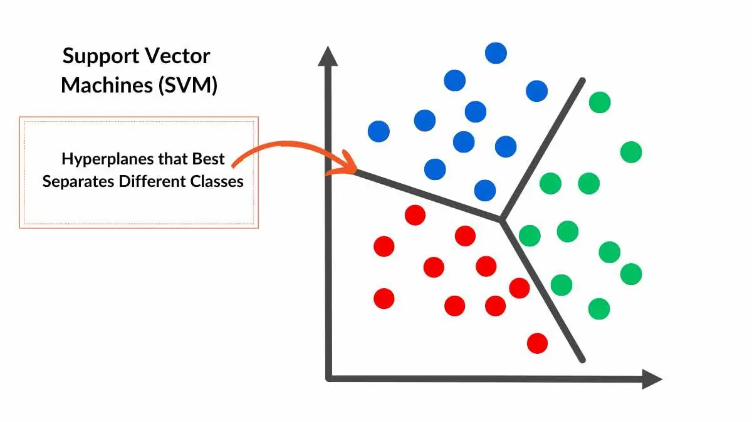
Support vector Classifier
The chosen model is the Support Vector Machine.
SVC is a specific implementation of the Support Vector Machine algorithm that is designed specifically for classification tasks.
All the models were tested with grid search, which helped to find the best hyperparameters for the models.
Best result: 64% accuracy

Slide 17

Evaluation

Slide 18
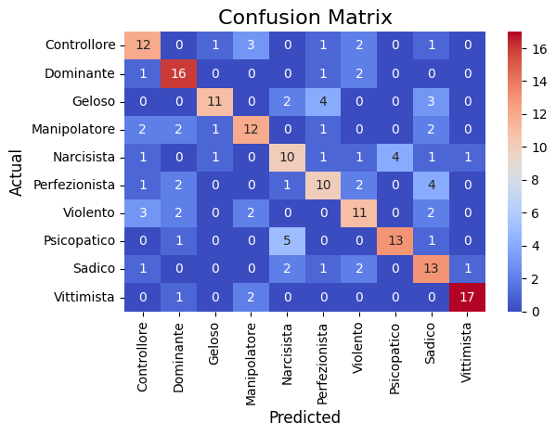
results
Several metrics have been evaluated:
Accuracy
Micro-average precision
Macro-average precision
Micro-average recall
Macro-average recall
Micro-average f1-score
Macro-average f1-score

Slide 19
Robustness of the results
All the metrics gave a value between 62% and 64%. The very low standard deviation (0.03) values indicates that the model is consistent and reliable in its predictions.

Slide 20






Conclusions and Limitations
DATA AVAILABILITY
NEW CORPORA OF DATA
The limited size of the dataset and the little availability of Italian hate-speech dataset is a core problem.
Bigger corpora of data can significantly improve the accuracy of the model
MODEL AVAILABILITY
Computational complexity
The little availability of fine-tuned model on Italian languages, and specifically to Italian hate-speech detection models, lead to initial poor results.
The Support Vector Machine, is computionally expensive to run on large datasets.
PROPOSED METHOD
Better possible approaches
Sequence transformers and machine learning classification models led to better results.
With a larger corpus of data, fine-tuning becomes a powerful option.

